Slide 1
Chapter: Microwave Radio Communications and System Gain
Topics:
■ Define microwave
■ Describe microwave frequencies and microwave frequency bands
■ Contrast the advantages and disadvantages of microwave
■ Contrast analog versus digital microwave
■ Contrast frequency modulation with amplitude modulation microwave
■ Describe the block diagram for a microwave radio system

Slide 2
Microwave :
Microwaves are generally described as electromagnetic waves with frequencies that range from approximately 500MHz to 300GHz or more. Therefore, microwave signals, because of their inherently high frequencies, have relatively short wavelengths, hence the name “micro” waves.
Example:
A 100-GHz microwave signal has a wavelength of 0.3cm, where as a 100-MHz commercial broadcast-band FM signal has a wavelength of 3 m. The wave lengths for microwave frequencies fall between 1 cm and 6 cm

Slide 3
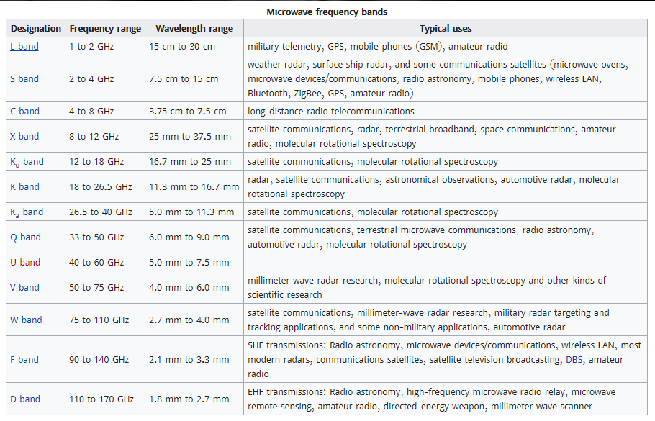

Slide 4
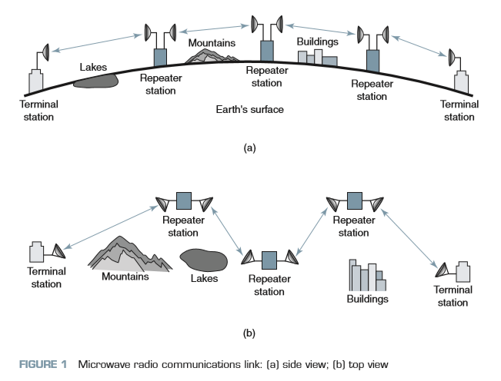
Microwave radio communications link:

Slide 5
Advantages of Microwave Radio
Radio systems do not require a right-of-way acquisition between stations.
Each station requires the purchase or lease of only a small area of land.
Because of their high operating frequencies, microwave radio systems can carry large quantities of information.
High frequencies mean short wavelengths, which require relatively small antennas.
Radio signals are more easily propagated around physical obstacles such as water and high mountains.
Fewer repeaters are necessary for amplification.
Distances between switching centers are less.
Underground facilities are minimized.
Minimum delay times are introduced.
Minimal crosstalk exists between voice channels.
Increased reliability and less maintenance are important factors.

Slide 6
Disadvantages of Microwave Radio
It is more difficult to analyze and design circuits at microwave frequencies.
Measuring techniques are more difficult to perfect and implement at microwave frequencies.
It is difficult to implement conventional circuit components (resistors, capacitors, inductors, and so on) at microwave frequencies.
Transient time is more critical at microwave frequencies.
It is often necessary to use specialized components for microwave frequencies.
Microwave frequencies propagate in a straight line, which limits their use to line-of-sight applications.

Slide 7
Analog versus Digital microwave:
A vast majority of the existing microwave radio systems are frequency modulation, which of course is analog. Recently, however, systems have been developed that use either phase shift keying or quadrature amplitude modulation, which are forms of digital modulation. This shift occurred because, in general, digitizing signal transmission improves network performance and capacity.
Frequency modulation versus Amplitude modulation:
Frequency modulation (FM) is used in microwave radio systems rather than amplitude modulation (AM) because AM signals are more sensitive to amplitude nonlinearities inherent in wideband microwave amplifiers. FM signals are relatively insensitive to this type of nonlinear distortion and can be transmitted through amplifiers that have compression or amplitude nonlinearity with little penalty. In addition, FM signals are less sensitive to random noise and can be propagated with lower transmit powers.

Slide 8
Frequency-Modulated Microwave Radio System:
Microwave radio systems using FM are widely recognized as providing flexible, reliable, and economical point-to-point communications using Earth’s atmosphere for the transmission medium. FM microwave systems used with the appropriate multiplexing equipment are capable of simultaneously carrying from a few narrowband voice circuits up to thousands of voice and data circuits. Microwave radios can also be configured to carry highspeed data, facsimile, broadcast-quality audio, and commercial television signals.
Baseband Signal:
The baseband is the composite signal that modulates the FM carrier and may comprise one or more of the following:
Frequency-division-multiplexed voice-band channels
Time-division-multiplexed voice-band channels
Broadcast-quality composite video or picturephone
Wideband data

Slide 9
FM Microwave Radio System:
Microwave radio has two component Transmitter and Receiver.
FM Microwave Radio Transmitter :
In the FM microwave a preemphasis network precedes the FM deviator. The preemphasis network provides an artificial boost in amplitude to the higher baseband frequencies. This allows the lower baseband frequencies to frequency modulate the IF carrier and the higher baseband frequencies to phase modulate it. This scheme ensures a more uniform signal-to-noise ratio throughout the entire baseband spectrum. An FM deviator provides the modulation of the If carrier that eventually becomes the main microwave carrier. Typically, IF carrier frequencies are between 60MHz and 80MHz, with 70 MHz the most common. Low-index frequency modulation is used in the FM deviator. Typically, modulation indices are kept between0.5 and 1. This produces a narrowband FM signal at the output of the deviator. Consequently, the IF bandwidth resembles conventional AM and is approximately equal to twice the highest baseband frequency. The IF and its associated sidebands are up-converted to the microwave region by the mixer, microwave oscillator, and bandpass filter. Mixing, rather than multiplying, is used to translate the IF frequencies to RF frequencies because the modulation index is unchanged by the heterodyning process. Multiplying the IF carrier would also multiply the frequency deviation and the modulation index, thus increasing the bandwidth.

Slide 10
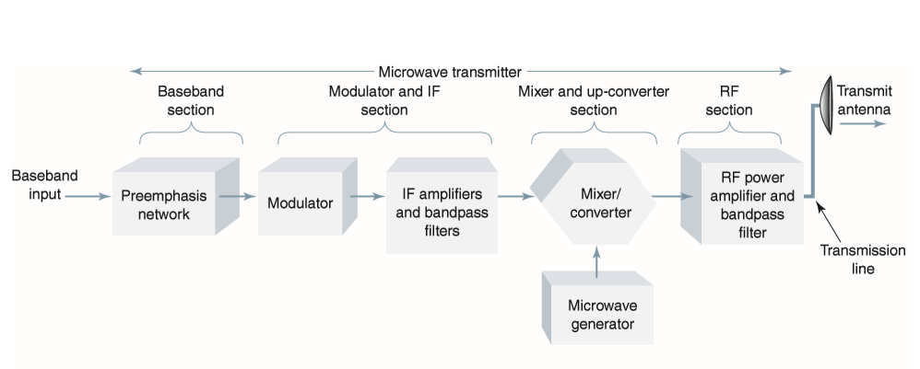
Block diagram of Microwave transmitter:

Slide 11
FM Microwave Radio Receiver:
In the FM microwave the channel separation network provides the isolation and filtering necessary to separate individual microwave channels and direct them to their respective receivers. The bandpass filter, AM mixer, and microwave oscillator down-convert the RF microwave frequencies to IF frequencies and pass them on to the FM demodulator. The FM demodulator is a conventional, noncoherent FM detector (i.e., a discriminator or a PLL demodulator). At the output of the FM detector, a deemphasis network restores the baseband signal to its original amplitude-versus-frequency characteristics.

Slide 12
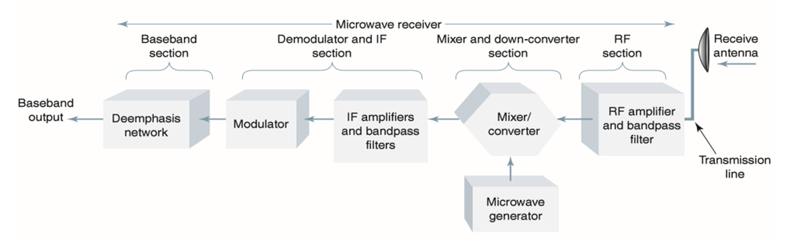
Block diagram of Microwave receiver:

Slide 13
Thank You
Presented BY:
Md. Ashikur Rahman
ASH1701001M
2. Md. Kamrul Hasan Tuhin
ASH1701002M
3. Md. Tohiduzzaman
ASH1701005M

